Slide 1








Thinking outside of the box truck
Sourcing Opportunities

Slide 2
Title (kylee’s stuff...)
  Paragraph

Slide 3


Primarius Web Window
  Online shopping sourced from a mixture of purchased and donated items.
  Orders can be placed for pick-up or delivery when ordered within 72 hours of scheduled deliveries
  Agency Relations Coordinators send reminder and updates weekly

Slide 4
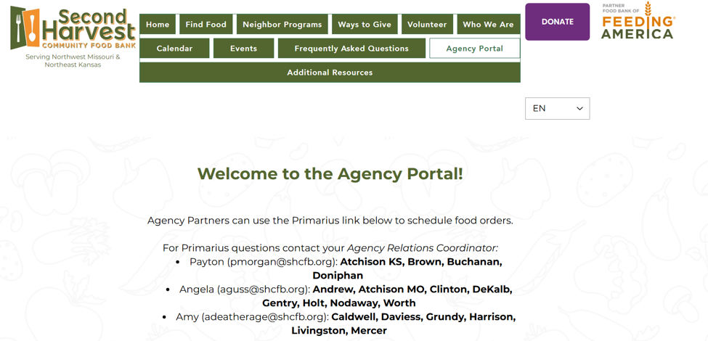
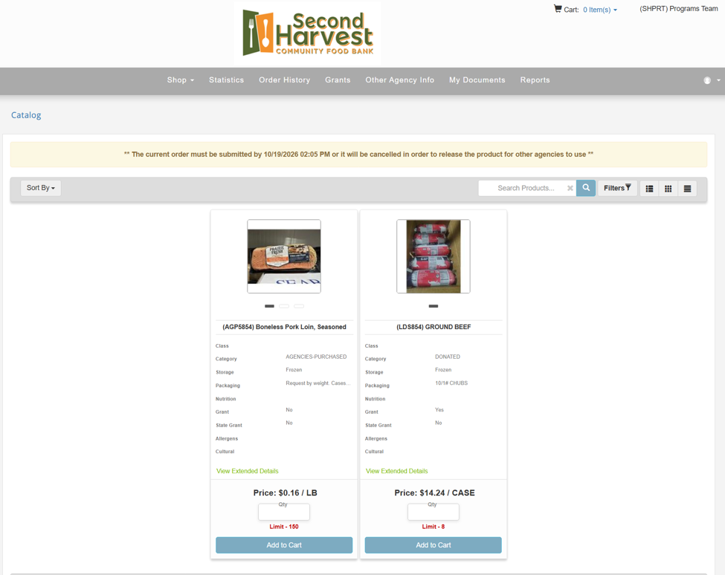

Log into the web window from the agency portal on our website
Start shopping for perishable and nonperishable items!

Slide 5


Grocery Store
Our new and improved agency grocery store at
Second Harvest with a convenient drive-up loading dock!
Item categories:
Canned Fruits & Veggies, Easy Meals
Cereal & Breakfast, Baking Items
Pasta & Sauces, Soups, Peanut Butter
Snack Foods, Bulk Foods
Hot Buy Items!

Slide 6
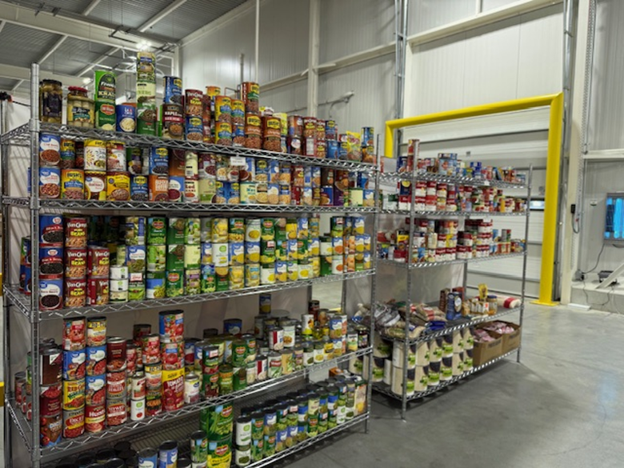
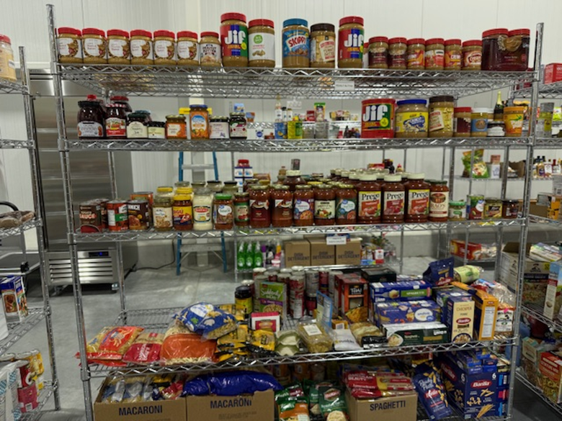
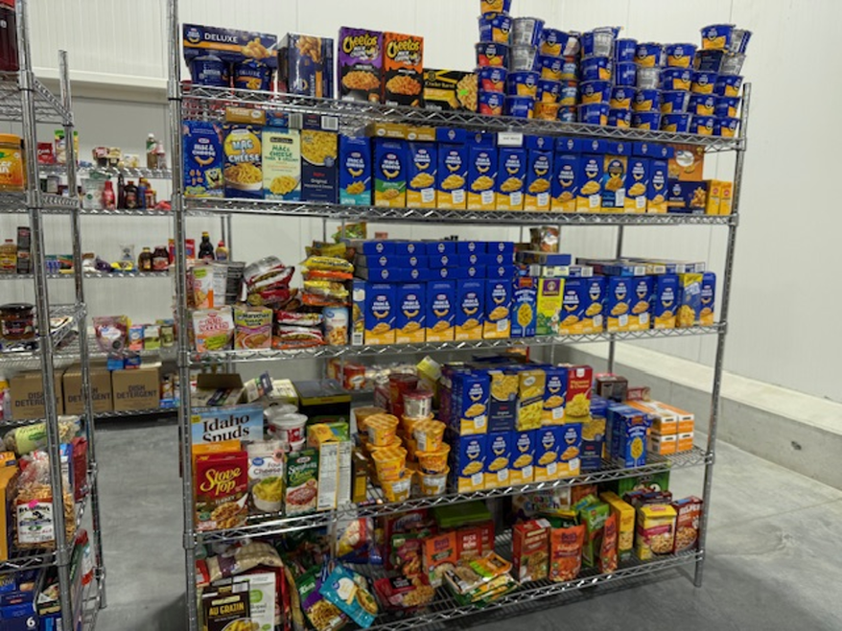
Shopping appointments are made at least one week in advance
Donated Items from:
Manufacturers
Corporations
Individuals
Most items are donated meaning they only cost $0.16/lb shared maintenance

Slide 7


Retail rescue
  Donations coming from retailers to help prevent food waste and get extra resources to our partners
  Items that can no longer be sold such as close dated items, day old products, and items that have been damaged but are still safe for consumption
  National retailers partnered through Feeding America such as WalMart, Dollar General, and Casey’s
  Agencies pick up directly from retailers
  Agency Relations Coordinators help facilitate relationships with retailers

Slide 8
questions?

