Slide 1















Slide 2
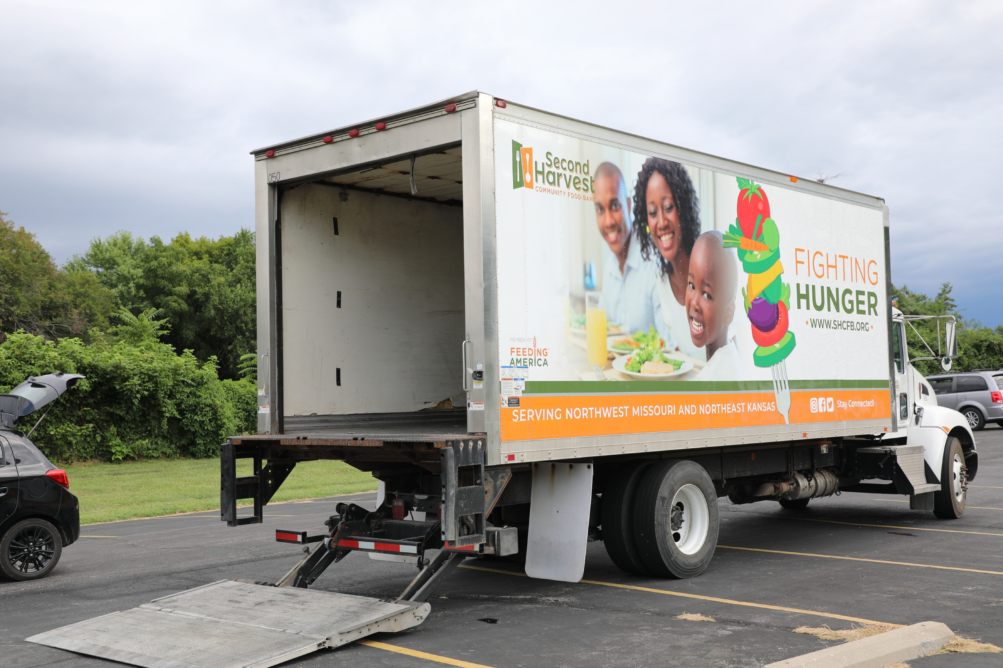


Slide 3



Grab a crate, Grab a tag, label it and put it back.
There’s the rice and there’s the beans,
There’s the whole kitchen scene.

Slide 4













We’re a food pantry here, a haven built on cheer.
Serving kids with a smile, working hard for a while.
Look at all the produce!

Slide 5

Lift a bin, seal a bag, ahh don’t lose that tag.
You’re the lifeblood of this service, everyone!

Slide 6

It’s the great work you do, for neighbors old and new.
Be our guest, be our guest, be our guest!

Slide 7


Yes it’s here, where we sort, do intake and check the dates.
Yes check the dates on all those slightly dented metal cans.

Slide 8
Helping kids grow tall, helping families not fall.
We’re a food pantry true, and we’ll help to see them through.

Slide 9

Families come here for a meal, cause it’s a really good deal.
And we’re thankful that you fill those bellies full!

Slide 10

We see so much good you do, serving others it’s true.
Be our guest, be our guest, be our guest!
Be our guest, be our guest, be our guest!

Slide 11

Civil Rights Training
USDA, Food and Nutrition Services
Civil Rights Division
Sept. 2022

Slide 12

Your Role
State agencies must conduct routine compliance reviews as identified by FNS Instruction 113-1 and program-specific regulations and policies.
  Civil Rights training must be provided annually to any staff or volunteer member that has personal contact or they are handling personal information of the participant.
  At the end of this training, staff:
    Should be able to identify a civil rights complaint if received
    Should know what to do if they receive a complaint
    Should understand that it is the basic right of the individual to file a complaint.
  A log should be kept when training has been completed and the information should be available during your monitoring visit.

Slide 13
TEFAP Program Regulations:
  7 CFR Part 250 and 251
  Sections 4(a) and 5 of the Agriculture and Consumer Protection Act of 1973 (public Law 93-86), as amended
  The Emergency Food Assistance Act of 1983 (Public Law 98-8), as amended
  FNS Instruction 113-1 and Appendix C

Slide 14
What is discrimination?
Discrimination is defined as the act of distinguishing one person or group of persons from others, either intentionally, by neglect, or by the effect of actions or lack of actions based on the protected classes.

Slide 15
Protected classes in TEFAP
The following are protected classes:
  Race
  Color
  National Origin
  Sex (including sexual orientation and gender identity)
  Disability
  Age
  Reprisal or Retaliation for prior civil rights activity in any program or activity conducted or funded by USDA
Note: Religious Creed is not a protected class for TEFAP.

Slide 16

What are civil rights
The nonpolitical rights of a citizen; the rights of personal liberty guaranteed to U.S. citizens by the 13th and 14th amendments to the U.S. Constitution and by acts of Congress.

Slide 17
Civil rights legal authorities
  Title VI of the Civil Rights Act of 1964 – Covers Race, Color & National Origin
  Civil Rights Restoration Act of 1987 – Clarifies the scope of the Civil Rights Act of 1964
  Section 504 of Rehabilitation Act of 1973; Americans w/Disabilities Act of 1990; and the Americans with Disabilities Act Amendments Act of 2008 – Disability
  Title IX of the Education Amendments of 1972 - Sex
  Age Discrimination Act of 1975 – Age

Slide 18
Civil rights legal authorities
7 CFR Parts 15, 15a, 15b, 15c
  USDA’s implementing regulations for nondiscrimination in Federally assisted programs. Gives USDA agencies authority to develop Civil Rights requirements
7 CFR Part 16, “Equal Opportunity for Religious Organizations”
  Fives equal footing to religiously affiliated organizations
Food and Nutrition Act of 2008, as amended
  Prohibits discrimination on the basis of race, color, sex, age, national origin, religion, political beliefs or disability
The Personal Responsibility and Work Opportunity Reconciliation Act of 1996
  Enforces Title VI of the Civil Rights Act of 1964 and related statutes in block grant type programs.

Slide 19
Civil rights legal authorities
28 CFR Part 35
  Covers nondiscrimination on the basis of disability in State/local government services (public entities)
28 CFR Part 36
  Covers nondiscrimination on the basis of disability by public accomodations
28 CFR 42
  Covers nondiscrimination in Federally assisted programs
Executive Order 13166 - “Improving Access to Services for Person with Limited English Proficiency” (August 11, 2000)
“USDA Guidance to Federal Financial Assistance Recipients Regarding the Title VI Prohibition Against National Origin Discrimination Affecting Persons with Limited English Proficiency” (79 Fed. Reg. No, 229, Friday, [p. 70771 – 70784] USDA LEP Policy Guidance

Slide 20
Civil rights legal authorities
USDA Departmental Regulation 4330-2
  Prohibits discrimination in programs and activities funded in whole or in part by the USDA
USDA Departmental Regulation 4330-3
  Equal Opportunity Public Notification Policy
FNS Instruction 113-1
  Provides information on Civil Rights compliance and enforcement

Slide 21
Areas of civil rights compliance
  Public Notification Requirements
  Civil Rights Training
  Compliance Reviews
  Complaints of Discrimination
  Assurances
  Limited English Proficiency
  Disability Compliance
  Resolution of Noncompliance
  Data Collection

Slide 22
Public notification system
  All FNS assistance programs must include a public notification system.
  The purpose of this system is to inform applicants, participants and potentially eligible persons of the program availability, program rights and responsibilities, the policy of nondiscrimination, and the procedure for filing a complaint.

Slide 23
Elements of public notification
Program Availability
  Inform applicants, participants, and potentially eligible persons of their program rights and responsibilities and the steps necessary for participation
Complaint Information
  Must advise applicants and participants at the service delivery point of their right to file a complaint, how to file a complaint, and the complaint procedures
Nondiscrimination Statement
  All information materials and sources, including websites, must contain a nondiscrimination statement. At a minimum the nondiscrimination statement or a link to it must be include on the home page of the program information.

Slide 24
Public notification requirements
  Publicize TEFAP to all, including underserved populations and the entities that service them;
  Provide appropriate information in alternative formats for persons with disabilities; and in appropriate language(s) for LEP persons;
  Inform potentially eligible persons, applicants, participants and grassroots organizations of programs or changes in programs;
  Convey the message of equal opportunity in all photos and other graphics that are used to provide program or program-related information; and
  Display the “And Justice For All” poster in a prominent location.

Slide 25
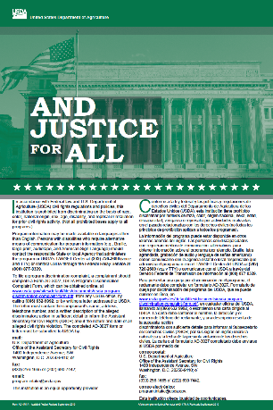
“and justice for all” poster
  Display the poster in a prominent location for all to view.
  AD-475A (Green) is the version for the TEFAP program.

Slide 26
Nondiscrimination Statement (Revised May 2022)
Full statement
In accordance with federal civil rights law and U.S. Department of Agriculture (USDA) civil rights regulations and policies, this institution is prohibited from discriminating on the basis of race, color, national origin, sex (including gender identity and sexual orientation), disability, age, or reprisal or retaliation for prior civil rights activity.
Program information may be made available in languages other than English. Persons with disabilities who require alternative means of communication to obtain program information (e.g., Braille, large print, audiotape, American Sign Language), should contact the responsible state or local agency that administers the program or USDA’s TARGET Center at (202) 720-2600 (voice and TTY) or contact USDA through the Federal Relay Service at (800) 877-8339.
To file a program discrimination complaint, a Complainant should complete a Form AD-3027, USDA Program Discrimination Complaint Form which can be obtained online at: https://www.usda.gov/sites/default/files/documents/USDA-OASCR%20P-Complaint-Form-0508-0002-508-11-28-17Fax2Mail.pdf, from any USDA office, by calling (866) 632-9992, or by writing a letter addressed to USDA. The letter must contain the complainant’s name, address, telephone number, and a written description of the alleged discriminatory action in sufficient detail to inform the Assistant Secretary for Civil Rights (ASCR) about the nature and date of an alleged civil rights violation. The completed AD-3027 form or letter must be submitted to USDA by:
Mail:
U.S. Department of Agriculture
Office of the Assistant Secretary for Civil Rights
1400 Independence Avenue, SW
Washington, D.C. 20250-9410; or
Fax:
(833) 256-1665 or (202) 690-7442; or
Email:
program.intake@usda.gov
This institution is an equal opportunity provider.

Slide 27
Nondiscrimination Statement
  Include the nondiscrimination statement on all materials that describe TEFAP benefits; including websites.
  For radio or television public service announcements, the nondiscrimination does not have to be read in its entirety. A short statement is sufficient.

Slide 28
Minimum (Short) Nondiscrimination Statement
  The long statement is to be used in most instances. The use of the shorter statement is an exception, not the rule and should only be used in special circumstances.
  If written material is too small to permit the full statement to be included, the material will at a minimum include the following statement in print no smaller than the text:
“This institution is an equal opportunity provider”

Slide 29
Nondiscrimination Statement Exception
  A nondiscrimination statement is not required to be imprinted on items such as cups, buttons, magnets, pens, etc. that identify TEFAP when the size or configuration makes it impractical.

Slide 30
Civil rights complaint handling
Right to File a Complaint:
  Any person alleging discrimination based on race, color, national origin, sex, disability, age or reprisal or retaliation for prior civil rights activity in any program or activity conducted or funded by USDA, has a right to file a complaint within 180 days of the alleged discriminatory action.

Slide 31
Civil rights complaint handling
  All civil rights complaints, written, verbal or anonymous, shall be accepted and forwarded to the FSD Food Distribution Unit within 48 hours.
  Confidentiality is extremely important and must be maintained
  A complaint form may be developed, but the use of such forms cannot be a pre-requisite for acceptance.
  The State agency will forward the complaint to the FNS Regional Office and DSS Office of Civil Rights within 5 business days.

Slide 32
Contents of a civil rights complaint
  Name, address and telephone number, or other means of contacting the complainant;
  Specific location and name of the agency delivering the service or benefit;
  Nature of the incident or action that led the complainant to feel discrimination was a factor, and an example of the method of administration which is having a disparate effect on the public, potential eligible persons, applicants, or participants;

Slide 33
Contents of a civil rights complaint
  The basis on which the complainant believes discrimination exists;
  The names, telephone numbers, titles, and business or personal addresses of persons who may have knowledge of the alleged discriminatory action; and
  The date(s) during which the alleged discriminatory actions occurred.
Note: The complaint form can be found online at:
https://www.usda.gov/oascr/how-to-file-a-program-discrimination-complaint

Slide 34
Assurances
To qualify for Federal assistance, written assurance that the program will be operated in compliance with all nondiscrimination laws, regulations, instructions, policies, and guidelines must be included in all agreements between agencies.
A Civil Rights assurance statement must be incorporated in all agreements between:
  Federal and State agencies (Federal-State Agreement)
  State agencies and local agencies/sponsors
  Local agencies/sponsors and sub recipients (if applicable)
(See FNS Instruction 113-1, Appendix B or FNS Form 74)

Slide 35

Limited English Proficiency (LEP)
Who are persons with LEP?
Individuals who do not speak English as their primary language and who have a limited ability to read, speak, write, or understand English because of their national origin.

Slide 36
LEP requirements
Title VI and its implementing regulations require recipients of Federal assistance (State agencies, local agencies, or other sub recipients), to take reasonable steps to ensure “meaningful” access to their programs and activities for individuals with limited English proficiency (LEP).
(FNS Instruction 113-1, Section VII)

Slide 37
LEP requirements
What is Meaningful Access?
  Providing reasonable, timely, appropriate and competent language services at no cost to individuals with LEP.
  Failure to provide meaningful” access may be discriminating on the basis of national origin.

Slide 38
LEP requirements
Factors to consider when ensuring “meaningful” access:
  Number or proportion of LEP persons eligible to be served or likely to be encountered within the area serviced by the recipient
  Frequency with which LEP individuals come in contact with the program
  Nature and importance of the program, activity, or service provided by the program
  Resources available and their costs.

Slide 39

Limited English Proficiency (LEP) and program access
Language services:
  Applicants and participants cannot be asked to bring their own interpreters
  Children (under the age of 18) should not be used as interpreters
  Use qualified, competent language resources
Examples of language services:
  Bilingual Staff (must be fluent in the language)
  Telephone interpreter lines
  Oral interpretation services
  Written language services
  Community organizations and volunteers

Slide 40
Disability discrimination
What is the definition of disability?
  A person who has a physical or mental impairment which substantially limits one or more major life activity, has a record of such an impairment, or is regarded as having such an impairment.
  Major life activity means functions such as caring for one’s self, performing manual tasks, walking, seeing, hearing, speaking, breathing, learning and working.
  Functions of the immune system, normal cell growth, digestive, bowel, bladder, neurological, brain, respiratory, circulatory, cardiovascular, endocrine, and reproductive functions.
(ADA Amendments Act of 2008)

Slide 41
Disability discrimination
  Sections 504 and 508 of the Rehabilitation Act of 1973
    prohibit discrimination based on disability in programs or activities receiving Federal assistance
  Americans with Disabilities Act (ADA), 28 CFR Part 35, Title II, Subtitle A
    prohibits discrimination on the basis of disability in all services, programs and activities provided to the public by State and local governments.
  These Civil Rights laws protect persons with disabilities who apply for or participate in all FNS-funded programs.

Slide 42
Disability discrimination
Reasonable modifications must be made in policies and practices for persons with disabilities in order to access benefits.
This means that it is almost never appropriate to deny someone an auxiliary aid or service based on the fact that the requested accommodation runs counter to established ways of doing things (policies and practices).

Slide 43
Disability discrimination
Reasonable Modifications
A public entity shall make reasonable modifications in policies, practices, or procedure when the modifications are necessary to avoid discrimination on the basis of disability, unless the public entity can demonstrate that making the modifications would fundamentally alter the nature of the service, program or activity. [28 CFR 35.130(b)(7)(i)]

Slide 44
Compliance reviews
There are three types of compliance reviews:
  Pre-Award Compliance Reviews
  Routine (Post-Award) Compliance Reviews
  Special Compliance Reviews

Slide 45
Pre-award compliance reviews
State agencies, subrecipient agencies, and local sites must be in compliance with Civil Rights requirements prior to approval for Federal financial assistance.

Slide 46
Routine/post-award reviews
FNS and State agencies must conduct routine compliance reviews as identified by FNS Instruction 113-1 and program-specific regulations and policies.
Assess all of the Civil Rights compliance areas.

Slide 47
Routine/post-award reviews
Sample post-award review questions:
  Do printed materials contain the nondiscrimination statement?
  Is the “And Justice For All’ poster displayed appropriately?
  Are program informational materials available to all?
  How are applicants and participants advised of their rights to file a Civil Rights complaint of discrimination?
  Are reasonable modifications appropriately made for people with disabilities?

Slide 48
Special compliance reviews
  May be scheduled or unscheduled
  To follow-up on previous findings of noncompliance
  To investigate reports of noncompliance by other agencies, media, or grassroot organizations
  May be specific to an incident or policy
  History of statistical underrepresentation of particular group(s)
  Pattern of complaints of discrimination

Slide 49
Resolution of noncompliance
  A factual finding that any civil rights requirement, as provided by law, regulation, policy, instruction, or guidelines, is not being adhered to by a State agency, subrecipient agency, or a local site.
  Steps must be taken immediately to obtain voluntary compliance
  A finding’s effective date is the date of notice to the reviewed entity.

Slide 50
Conflict resolution & customer service
Conflict Resolution and Customer Service Techniques should be incorporated in each annual Civil Rights training for frontline staff to help ensure that any issues arise are resolved at the lowest level, as unresolved conflict may lead to a Civil Rights Complaint.

Slide 51
Conflict resolution & customer service
Conflict Resolution Techniques:
  Take a deep breath and calm down
  Be objective and view the situation in a neutral way
  Be mindful of nonverbal communication
  Avoid person attacks, insults, or defensiveness
  Show genuine care and concern for the customer
Conflict Service Techniques:
  Use plain language to explain policies and procedures
  Actively listen to the client
  Be proactive and make the extra effort
  Address the client by his/her name
  Ask for required documentation in a courteous way, don’t rudely demand information

Slide 52
Voluntary resolution agreement
  A Voluntary Resolution Agreement (VRA) is an agreement that recipient(s) are willfully consenting to undertake remedial actions to address identified areas of noncompliance or in violation with applicable civil rights laws and/or regulations.
  The VRA may be between multiple parties such as the officials in authority to regulate civil rights laws (Food and Nutrition Service, Civil Rights Division, (FNS CRD)), recipient or sub-recipient (State agency or school), and program participant (Complainant).
  Voluntary Resolution Agreements may be used to closeout a Civil Rights Compliance Review at the discretion of FNS CRD in lieu of issuing a written Compliance Review report with findings.

Slide 53
Food for thought
Staff and volunteers involved in the distribution of TEFAP commodities should ask themselves the following:
  Am I treating this person in the same manner I treat others?
  Have I given this person the opportunity to clarify all relevant factors or inconsistencies?
  Have I told this person exactly what information I need to make a determination on the application?
  Have I provided the person with the information he or she needs to make necessary decisions?

Slide 54
Thank you for being amazing partners and advocates!
Questions?

Slide 55

BRAIN BREAK
WITH AMY

Slide 56

Agency Partner Food Safety
WITH COREY

Slide 57

Introduction to Food Safety
  The objective of this session is to provide you with information that can help you protect the safety of the food you or others handle. Your efforts must be proactive versus reactive.
  Food safety is about preventing contamination from bacteria, chemicals, physical objects, and allergens.
  As a food handler, you are part of the food industry, and the care you provide protects the members you serve.
  Share your knowledge of food safety with your coworkers and fellow volunteers.
  Food safety is essential in any environment where food is handled, stored, or distributed—especially in food banks, where we serve some of the most vulnerable members of our community.
  Ensuring that all donated and distributed food is safe helps protect the health of clients and upholds the integrity and trust in our organization.

Slide 58
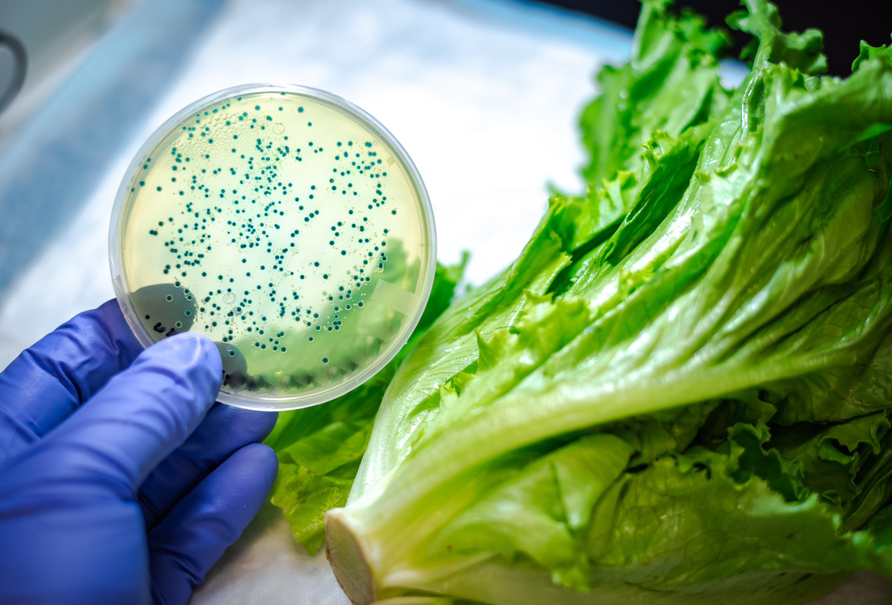

By the Numbers
  The CDC (Centers for Disease Control and Prevention) estimates that each year in the United States:
    48 million people get sick from a foodborne illness
    128,000 people are hospitalized
    3,000 people die
  Estimates include illnesses caused by 31 known pathogens and other unspecified agent
  The most common causes include:
    Norovirus
    Salmonella
    E. coli

Slide 59

Why Food Safety Matters
•Protects health: Contaminated food can cause foodborne illnesses, which may be especially dangerous for young children, the elderly, pregnant women, and individuals with weakened immune systems.
•Prevents waste: Proper handling and storage reduce spoilage and ensure more food reaches people in need.
•Maintains trust: Safe practices show donors and recipients that we take our responsibility seriously.

Slide 60
How Food Becomes Unsafe
Many hazards can make food unsafe and cause a food borne illness.
  Common causes:
    Biological Hazards
      Bacteria, viruses, and parasites (e.g., Salmonella, Norovirus, etc.)
    Chemical Hazards
      Cleaning agents, pesticides, or allergens not properly labeled
    Physical Hazards
      Foreign objects like glass, metal, or plastic.
    Poor personal hygiene
    Time Temperature abuse
    Cross contamination
    Poor cleaning or sanitizing

Slide 61
Basic Food Safety Practices
  Inspect Food
    Look for mold, off-odors, discoloration, or damaged packaging
  Temperature Control
    Keep perishable items refrigerated or frozen
    Cold foods below 41°F and hot foods above 135°F
    Never leave cold items out for more than 2 hours
  Separate Food Types
    Store raw meats separately from ready-to-eat foods
  FIFO Inventory Practices
    First in, First out to rotate stock

Slide 62

Temperature & Control (TCS) Foods
  TCS Foods are foods that must be kept at safe temperatures to prevent the growth of harmful bacteria.
  The “Danger Zone”: 41°F - 135°F
    Bacteria can double every 20 minutes in the danger zone.
  Some foods are more susceptible to pathogen growth.
    Milk and dairy products
    Meat, Poultry, and Fish
    Eggs
    Baked Potatoes
    Cooked rice, beans, and vegetables
    Sliced fruits & vegetables

Slide 63

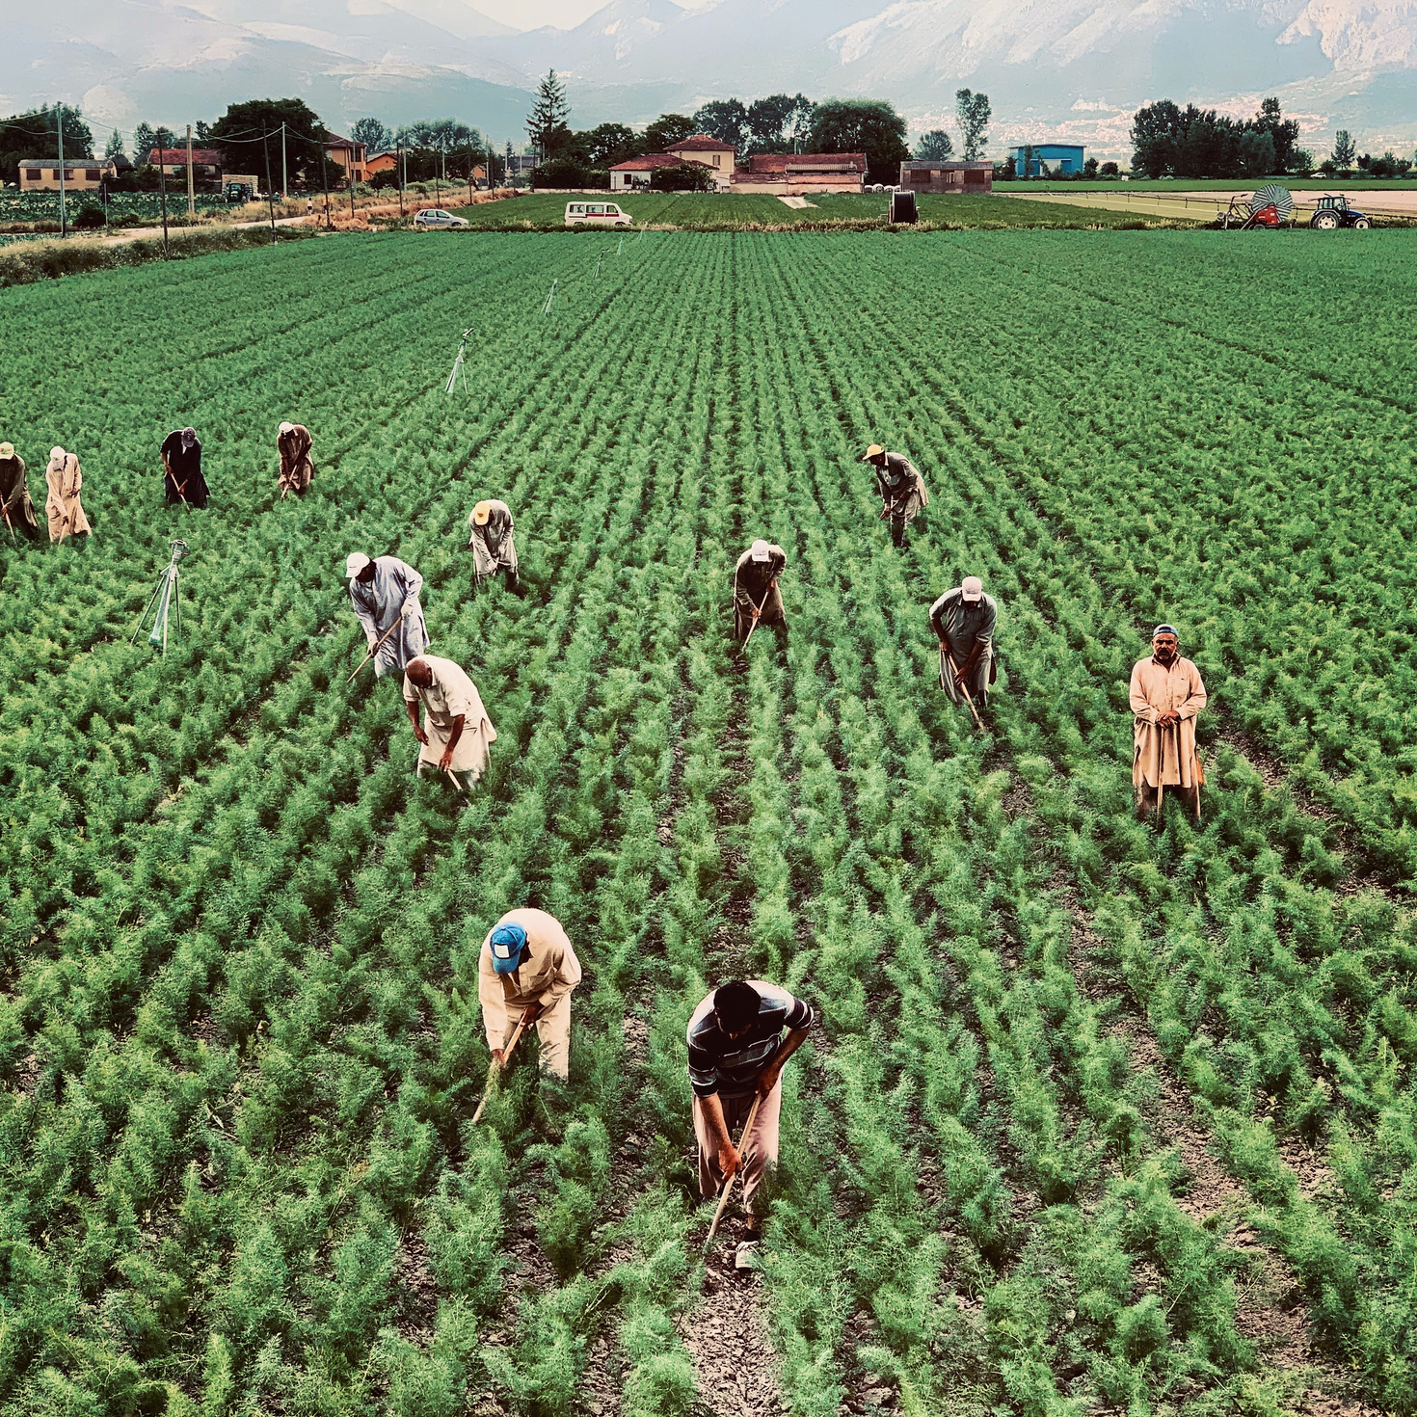
Controlling Time & Temperature
  Check the temperature of food and storage areas with an appropriate thermometer (keep a log if possible).
  Store and transport refrigerated foods at 41°F, or less.
  Store and transport frozen foods at 0°F, or less.
  Store whole produce at room temperature, and cut produce at 41°F, or less.
  Document temperature readings for your refrigerators and freezers twice daily.
    Consider temperature monitoring devices
  Do not overload coolers or freezers.
    Leave space between walls and product to ensure proper airflow.

Slide 64

Thawing & Cooking TCS Foods
  Never thaw TCS food at room temperature.
  Acceptable ways to thaw foods include:
    In a cooler at 41°F or less
    Submerged under running water at 70°F or less
    In a microwave oven if the food is cooked immediately
    As a part of the cooking process
  Cooking food to safe levels includes:
    Poultry, 165°F
    Ground meat, 160°F
    Fish, 145°F
    Pork and beef (steaks or chops), 145°F

Slide 65

for Staff & Volunteers
  Thawed food should never be refrozen unless thawed in refrigeration and still safe.
  Use a food thermometer for any questionable product.
  Check temperatures of donated perishable food before accepting.
  If food is between 41°F and 135°F for over 2 hours, discard it.
  When in doubt, throw it out.

Slide 66
Personal Hygiene & Health
Good hygiene prevents contamination from hands, hair, skin, or illness.
  Always wash your hands—Your #1 Defense
    Before starting work
    After using restroom
    After touching your face, hair, or phone
    After handling garbage or cleaning products
  If you’re sick with vomiting, diarrhea, or fever, please stay home.
  Wear clean clothes, and use hairnets, hats, or beard covers when near food.
  Cover wounds or cuts with bandage and glove.

Slide 67
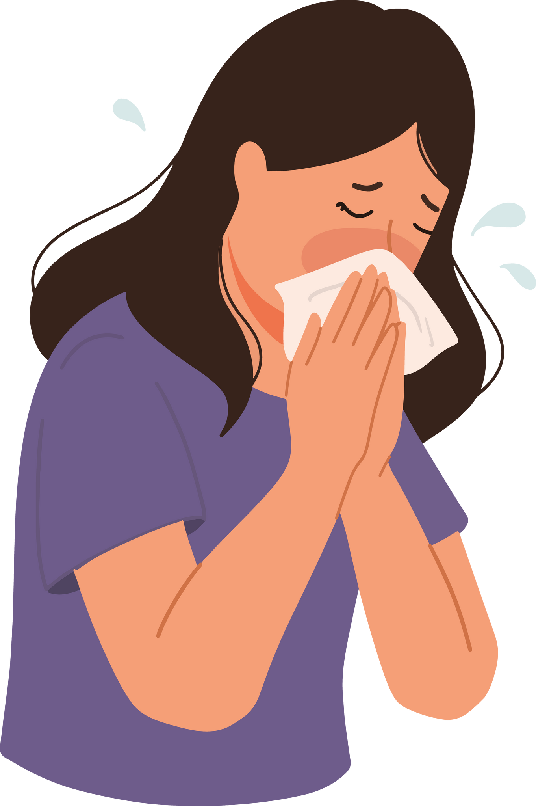
Real-Life Examples
  A volunteer forgets to wash hands after unpacking boxes from a truck—and handles fresh produce.
    Risk: Bacteria from outside surfaces can transfer to food.
  Someone sneezes into their hand and goes back to sorting dry goods.
    Risk: Spread of germs to food and packaging.
  A cut on someone’s hand is uncovered.
    Risk: Bloodborne pathogens, contamination.

Slide 68


Do
Recap:
Personal Hygiene Do’s & Don’ts
  Wash hands often
  Wear clean clothes
  Use gloves correctly
  Cover cuts and wounds
  Report illness
Don’t
  Work while sick
  Wear jewelry over food
  Reuse dirty gloves
  Touch face, hair, or phone
  Handle food when coughing or sneezing

Slide 69
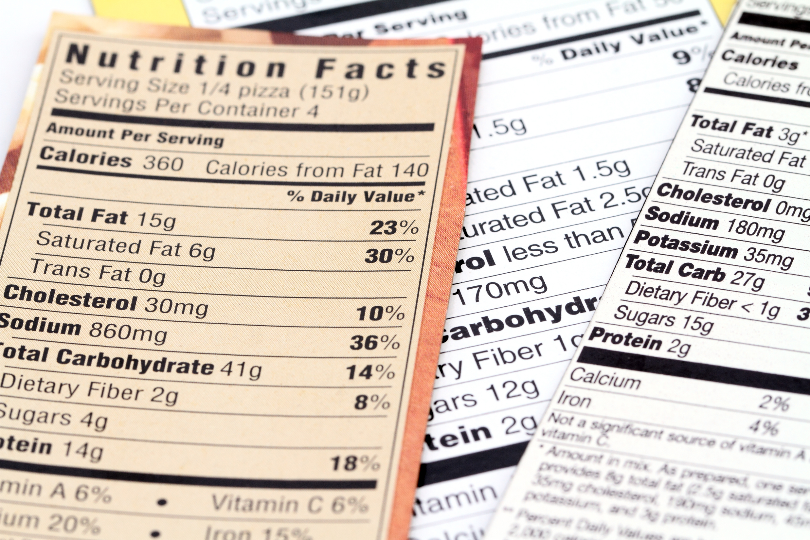
Proper Labeling of Food for Storage
  You must be able to tell when food was accepted and by what date it must be used by.
  All ready-to-eat (RTE) food must have a label that includes: name of food, ingredients, quantity, use-by or expiration date and manufacturer.
  Most foods we receive are okay to distribute past its expiration date. These foods include most non-perishable items. Please reference the Food Drive & Salvage Sorting Guidebook for recommendations.

Slide 70

Cross Contamination
  Many of the people we serve are more vulnerable to illness (e.g., seniors, children, those with chronic health conditions).
  Cross contamination is a major cause of foodborne illness and can happen easily if we’re not careful.
  Even small amounts of contamination can cause serious illness.
  It’s our responsibility to protect the food we distribute.
  Store foods in the proper order (top-down): ready-to-eat, raw seafood, red meat, and poultry.

Slide 71
How to Prevent Cross Contamination
  Hands touching raw meat, then touching canned goods
  A knife used to open boxes of raw food then used on RTE snacks
  Food stored with cleaning chemicals nearby
  Allergens (like peanuts) touching non-allergen items
  Using the same gloves for multiple tasks
  Leaky packaging contaminating surfaces or other food.

Slide 72
Preventing Cross Contamination Cont.
  Proper Handwashing
    Wash often and properly
    Use soap and warm water for 20 seconds.
  Use Gloves—Correctly
    Change between different tasks.
    Never wash or reuse disposable gloves.
  Separate Food Types
    Raw meat, even if it’s frozen or sealed, should always be kept separate from:
      RTE Foods
      Fresh Produce
      Baby formula or medical foods
    Use designated bins or areas for specific food types.

Slide 73



Tips for Volunteers & Staff
If you’re not sure if something is contaminated, set it aside and ask.
Follow signs posted in storage and food sorting areas.
Clean up spills immediately to prevent them from spreading contamination.

Slide 74

Cleaning & Sanitizing
Clean work areas keep food safe from contamination.
  Clean and sanitize food handling equipment and areas after every use. Always inspect prior to use.
  Always clean and sanitize after you are done with a task or start working with another type of food.
  Use cleaning and sanitation chemicals according to label instructions. Use Personal Protection Equipment (PPE).
  Handle garbage properly.
  Monitor and report all pest activity using the Pest Sighting Log (insects, rodents, and birds).
  Store chemicals and cleaning supplies away from food.

Slide 75
Receiving & Storing Food
Receipt
  Use reputable suppliers.
  Check all deliveries for: Temperature, sanitation, chemicals, pests, etc.
  Reject deliveries that have problems.
  Make sure food containers are not damaged.
  Make sure food is properly labeled.
  Store foods requiring refrigerated or frozen storage immediately at the proper temperature.

Slide 76
Receiving & Storing Food
Receipt
  Canned food must be labeled and not have:
    Swollen ends
    Leaks
    Seal problems
    Lids that are popped
    Major dents
    Rust
  When in doubt, throw it out!
  Check the Food Drive Sorting & Salvage Guidebook

Slide 77
Receiving & Storing Food
Storage
  Separate raw and cooked foods.
  Rotate food to ensure that the oldest food is used first. First In, First Out (FIFO).
  Check the shelf life of food.
  For dry goods, keep the temperature between 50-70°F
  Do not distribute baby food and formula after it has expired.

Slide 78
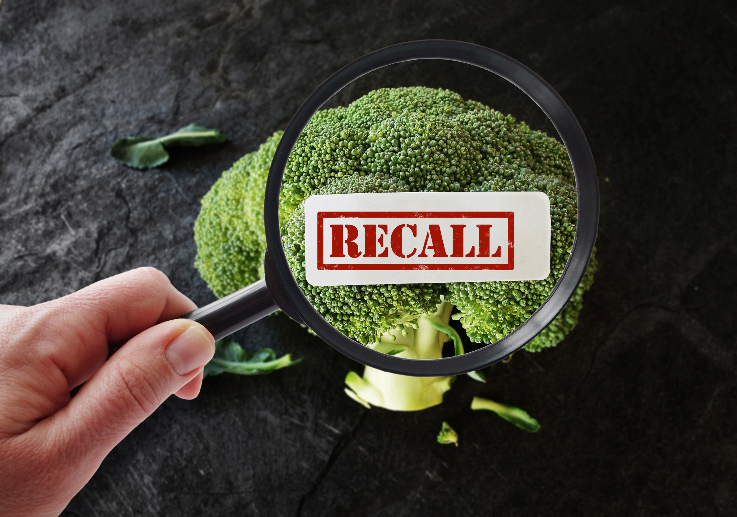
Recalls
  A food recall means a product is unsafe or mislabeled and must be removed from distribution.
  It could be due to:
    Contamination (e.g., Salmonella, Listeria, metal or plastic pieces)
    Undeclared Allergens (like peanuts or milk)
    Improper labeling
    Spoilage or potential for foodborne illness
  Serving recalled food – even by mistake – can endanger lives and seriously damage our food banks reputation.

Slide 79
What to do When a Recall Happens
  Identify the Product
    Match recall details to your inventory:
      Brand
      Product Name
      Size
      UPC/Barcode
      Lot code or expiration date
  Isolate the product
    Immediately remove the item from shelves, boxes, and distribution.
    Label it: “DO NOT DISTRIBUTE – RECALLED”
    Store it in a clearly marked area away from other food or dispose of it properly as instructed.

Slide 80
What to do When a Recall Happens
  Notify Staff and Volunteers
    Make sure everyone knows not to touch or redistribute the product.
    Put up signs or send out a brief notice.
  Follow Disposal Instructions
    Some recalls allow destruction on site; others may require return to vendor or regional food bank.
    Always follow the official instructions.
  Document the Action Taken
    Keep a record of the recalled product, how much was removed, and what was done with it.
    If you redistributed it before the recall, notify the recipient ASAP.

Slide 81
Tips for Staff & Volunteers
  Don’t Guess – always confirm product codes and lot numbers before removing.
  Check recall bulletins weekly if you’re in charge of inventory or distribution.
  If you’re unsure about an item, set it aside and ask.

Slide 82
Chief Operating Officer - TJ Bauer
Director of Logistics - Corey Ripper
Warehouse Manager - Gisselle Watts
Director of Programs - Kasi Norris
Programs Manager - Jeremy Glenn
Questions?

Slide 83
BREAK

Slide 84










FRESH MOBILE PANTRIES
with Deb

Slide 85




  26 monthly Fresh Mobile Pantries.
  11 days are an alternating site.
  A total of 45 locations, with all 18 counties being served.
  By mid-November, all sites will have Service Insights keytags for check-in.
Current Statistics

Slide 86




FY24 Fresh Mobile Pantry Totals
POUNDS:
2,461,366
INDIVIDUALS:
102,121
FAMILIES:
37,321
MOBILES:
330
**This does not include
Turkey Day or Holiday Express

Slide 87









SENIOR INITIATIVES
with Sydney

Slide 88

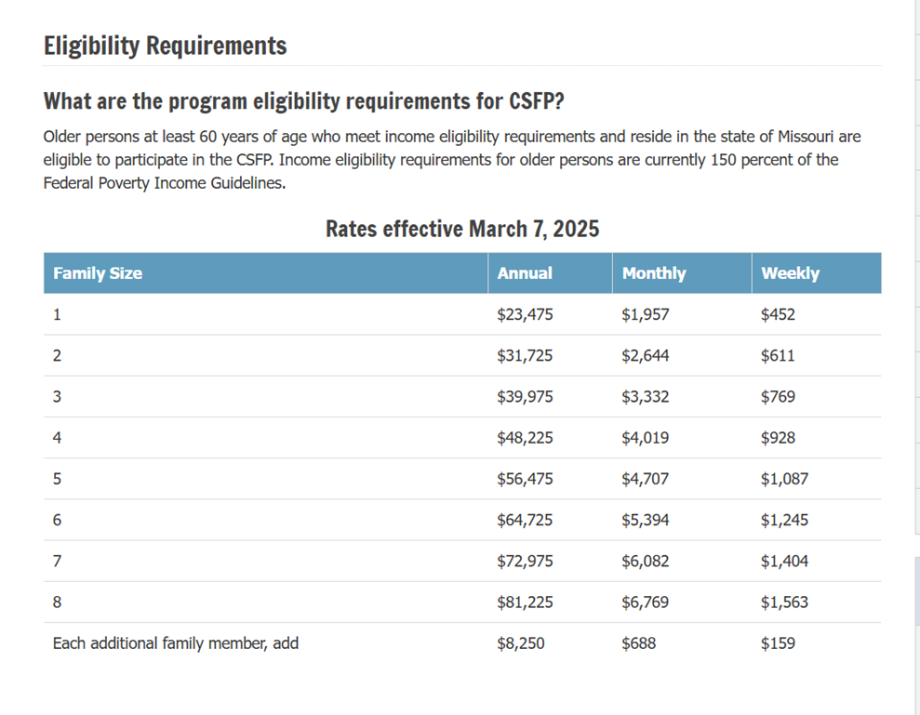
MO CSFP Senior Box
Who Qualifies?
•Participant must be over 60 years old.
•Must pick up in the county they live in.
•Income guidelines (self declared).

Slide 89








MO CSFP Senior Box
What’s in a box?
Shelf-stable milk
Cereal, Oats or Grits
Rice or Pasta
Meat and plant protein
Assorted fruits
and veggies
Cheese

Slide 90
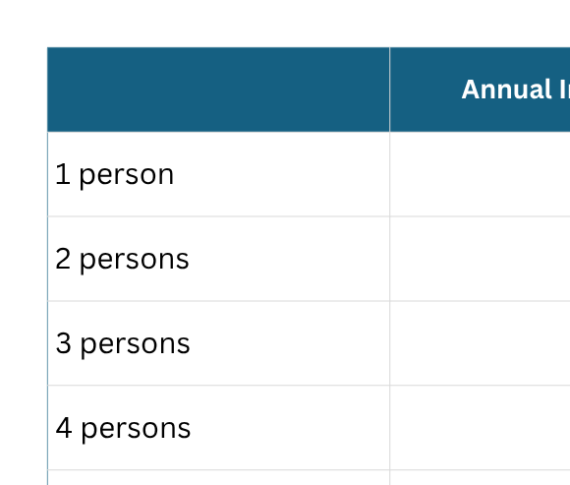
SH Supplement Senior Box
Who Qualifies?
•Participant must be over 60 years old.
•Must pick up in the county they live in.
•Income guidelines (self declared).

Slide 91


SH Supplement Senior Box
What’s in a box?
Shelf-stable milk
Peanut butter
Rice
Breakfast cereal
Pasta with sauce
Meat and plant protein
Assorted fruits and veggies

Slide 92

Where do we distribute?
Kansas
  Catholic Charities of Atchison
  Trinity Center FP
  South Brown FP
  New Life Church
Missouri
  Andrew County Ministries
  Community Services, Inc. (Tarkio)
  East Ridge Manor
  Chilton Apartments
  King Hill Apartments
  Saint Francis Apartments
  Village East Towers
  Wesley Senior Towers
  Woodbine Meadows
  Caldwell County FP
  First Baptist Church of Polo
  Second Harvest Community FB
Missouri
  Cameron Food Pantry
  Grace Trimble
  7th Day Adventist FP
  Dekalb Senior Center
  Albany Ministerial Alliance
  Community Food Bank of Grundy County
  Harrison County FP
  Community Service, Inc. (Mound City)
  Impact Mission Center
  Mercer County Senior Center
  Maryvile FP (Ministry Center)
  City of Skidmore

Slide 93

Your Role:
  Outreach
  Food storage safety
  Distribution
  Reporting
  Great communication
We can’t do this without you!

Slide 94











CHILDREN’S INITIATIVES
with Faith

Slide 95


COMMUNITY PARTNERSHIPS
with Andrew

Slide 96
ROLE AS THE COMMUNITY PARTNERSHIP MANAGER
  Build and nurture relationships with external partners to further Second Harvest’s mission.
  Foster engagement, secure resources, and create strategic collaborations with local businesses, civic organizations, churches and community groups.

Slide 97
HELP ME HELP YOU!
  In-Kind Donations
    Food producers, manufacturers, and growers
  Potential Funding Sources
    Identify corporations, businesses and groups in your community.

Slide 98
SOURCING THROUGH FOOD DRIVES
with Kylee

Slide 99
FOOD DRIVES
  Host a food drive.
    Local grocery stores
    Schools
    Churches
  Second Harvest as a Resource
    Provide a tool-kit to have a successful food drive.
    Share ideas.
    Build connections.
    Promotion
  New Region Wide Food Drive this December - 12 Days of Giving
  Breakout Session Two.

Slide 100




VOLUNTEER EXPERIENCE
with Nicole

Slide 101




Volunteer Opportunities
WAREHOUSE
SPECIAL EVENTS
FRESH MOBILE PANTRIES
Groups are scheduled to volunteer in our warehouse netting produce, packing senior boxes, packing family packs, sorting donations, and other projects we need help with!
Fill the Van and
Stamp Out Hunger food drives, Administrative tasks, and more.
Located in each of our 18 counties.

Slide 102

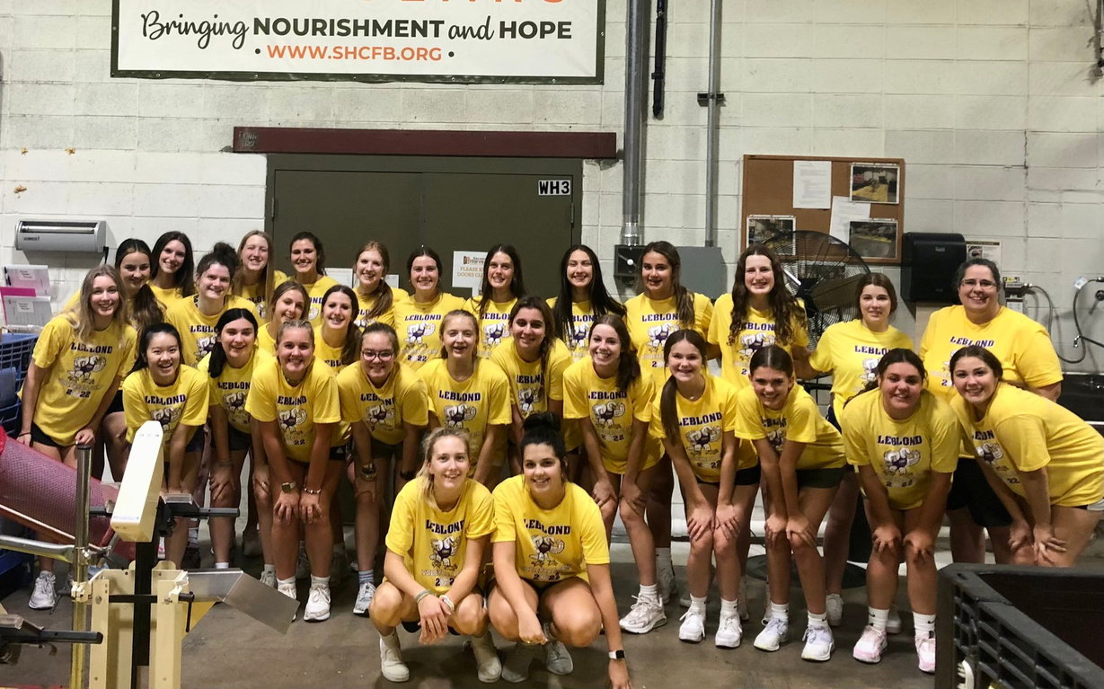

How I Can Be a Resource
  Volunteer recruitment
2. Volunteer appreciation and recognition

Slide 103


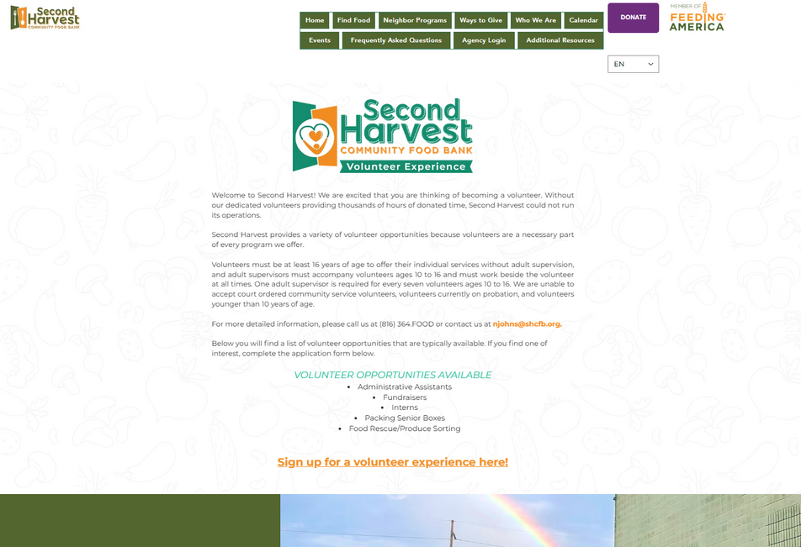

Navigating our Website

Slide 104

MO TEFAP
with Amy & James

Slide 105

What to expect if you are selected for a MO TEFAP State Inspection
Timeline
  Agency will receive a notification email in May. Email will provide the date and time of site visit, and a general overview.
  Required questionnaire with completion deadline.
  Second Harvest ARC will conduct a pre-inspection visit at your request.
  Inspection will be conducted in June
  Corrective Action Process will follow (if required). Must be submitted within 30 days.

Slide 106
Let’s Review Some Important Documents for Site Monitoring

Slide 107
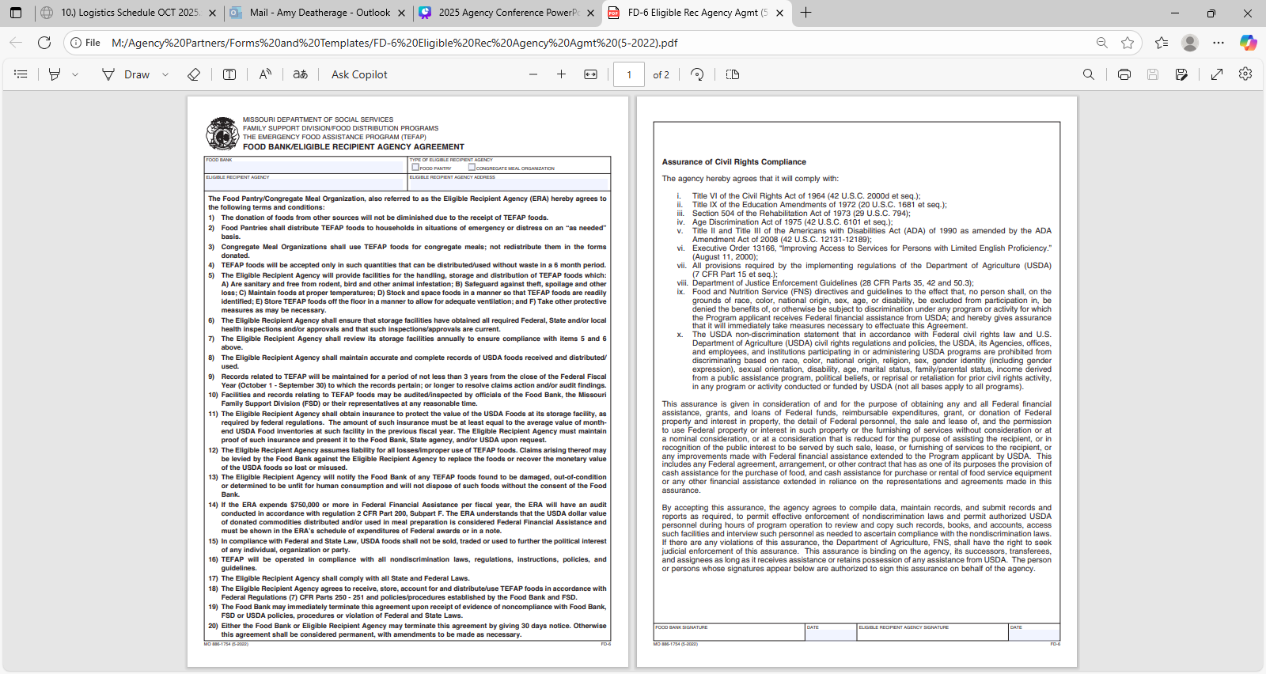
FD-6 Contract with All Signatures

Slide 108
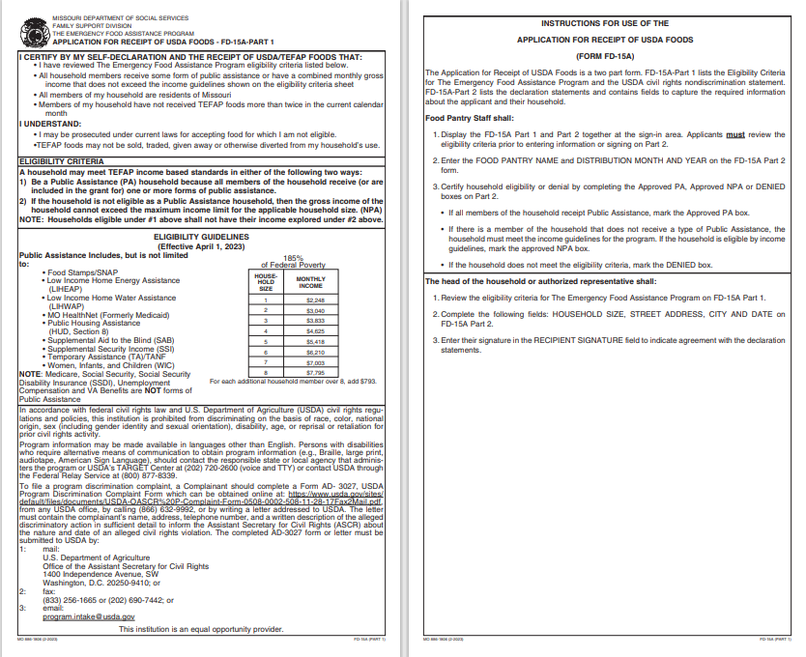
FD-15A Part 1 (Poverty Guidelines)

Slide 109
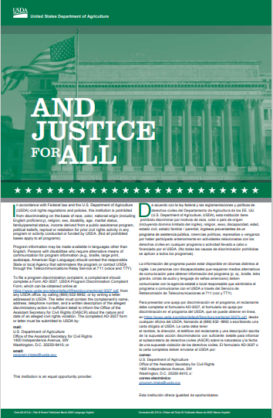
And Justice For All In Public View

Slide 110
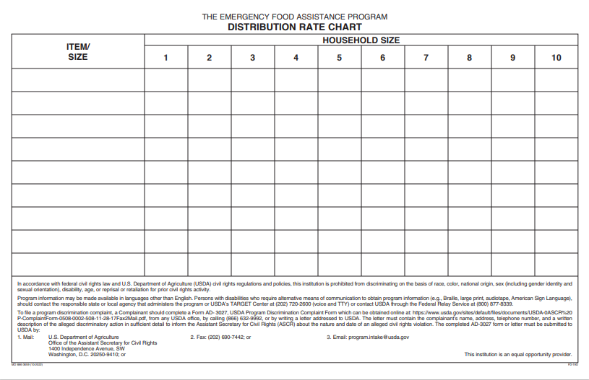
Distribution Rate Chart

Slide 111
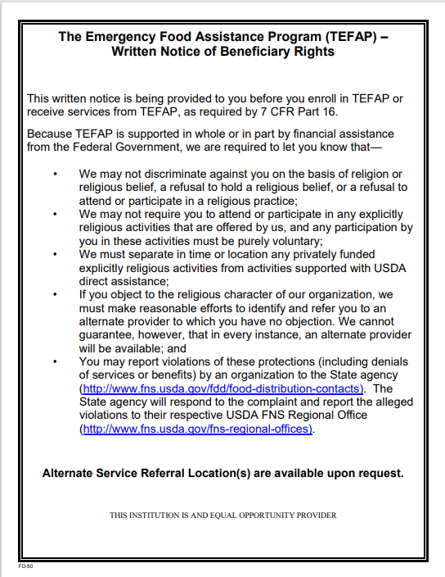
Written Notice of Beneficiary Rights

Slide 112
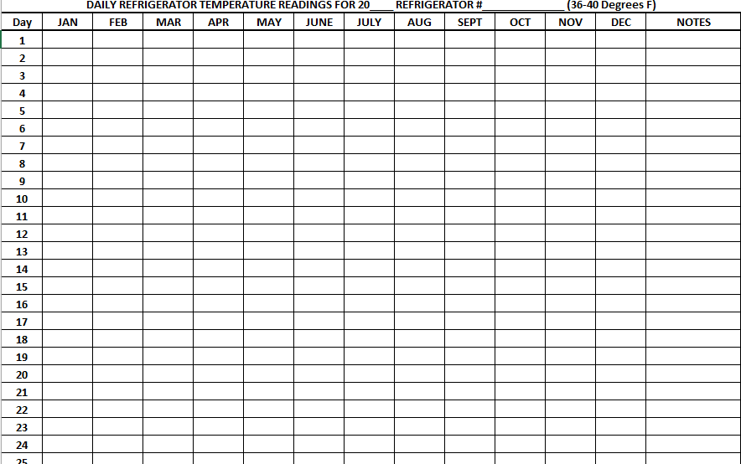
Temperature Logs
Temperature Log Requirements
  Fill Out Daily
  Must have 3 separate logs
    Refrigeration
    Frozen
    Dry Storage
  Thermometers must be on site and functioning properly

Slide 113
Additional Documents and Signage
· Visible signage indicating the location is a Food Pantry
· Hours posted and visible to neighbors
· Emergency Contact: After-hours number to call
· Show proof of 501(c)3/EIN

Slide 114
Common Questions You Will Have to Answer
· Are USDA foods given without charge?
· How often do you verify eligibility? (PA vs. NPA)
· Other programs offered?
· How often is Civil Rights Training?
· What is the process for a Civile Rights Complaint?
· How long do you keep records?
· What is your pest control process?
· What is your cleaning schedule?
· What is the process for proxy pick up and how is it recorded?
· What are your receiving and storage procedures?

Slide 115
Special Considerations
  Drive-thru distribution sites: All required postings must be visible to neighbors at the time of distribution.
    Include: Hours and Days of TEFAP distribution, Written Notice of Beneficiary, Poverty Income Guideline, And Justice for All.., and the Distribution Rate Chart
    Must display in a place that neighbors can see clearly from their vehicle
  Emergency After Hours phone number must be posted and visible from the outside
  Maintenance of Equipment: Defrosting freezers to avoid buildup
  Establish a public notification system Slide

Slide 116
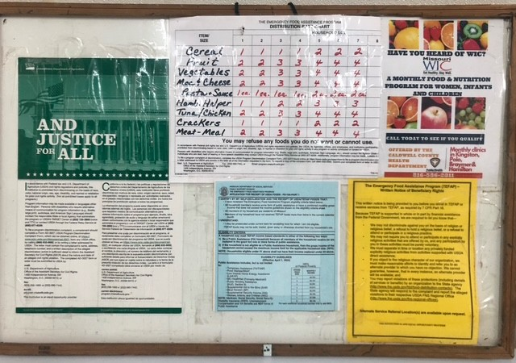
Drive Through Bulletin Board Example
Sample Board Provided by Braymer Food Pantry

Slide 117
What is a Public Notification System
A method of communication or advertising that encourages participation and informs all potential availability of USDA foods.
Methods of Public Notification
    Internet
    Newspaper articles
    Radio/television ads
    Newsletters, leaflets, brochures, bulletins, flyers
    Computer-based applications: Social Media
Public Notifications Must Include
    Name and Location
    Services Provided (Food Distribution)
    Hours of Service

Slide 118
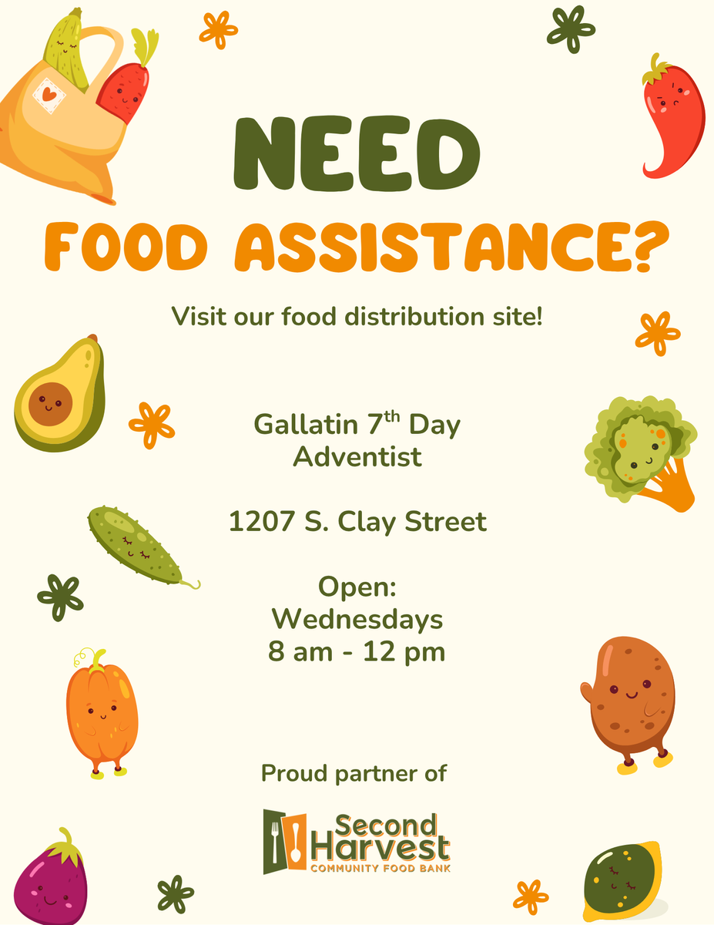
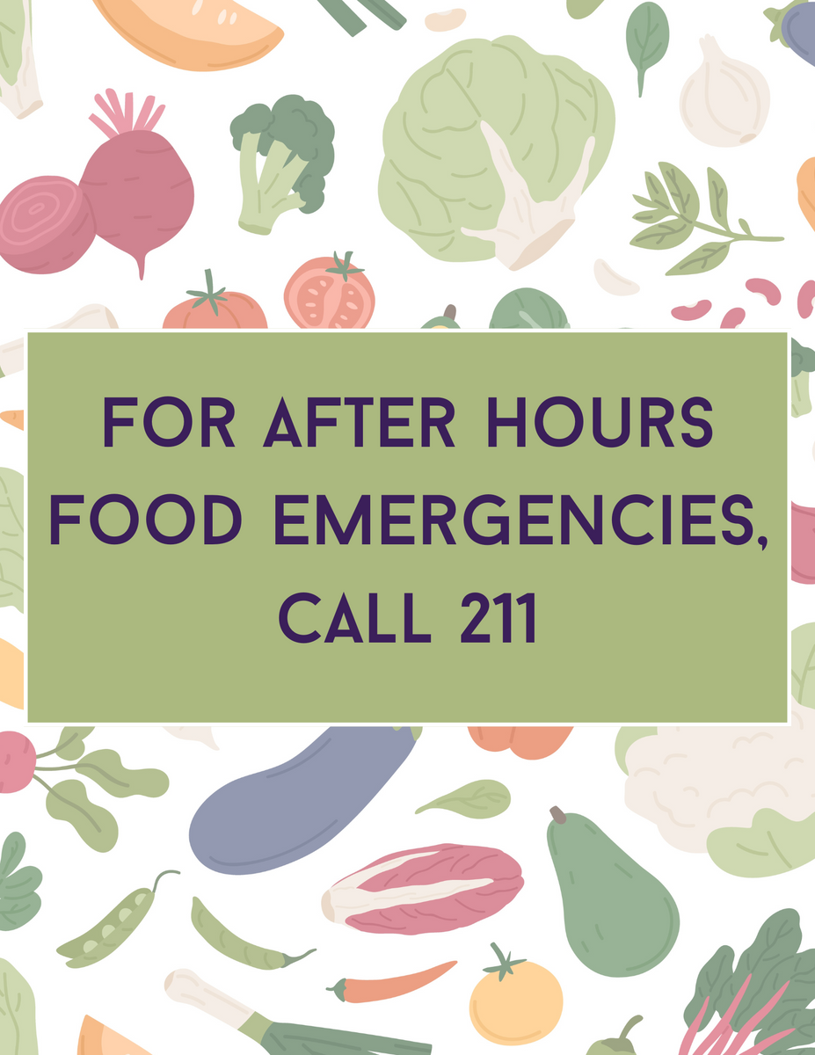
Outreach Flyer and After Hours Sign

Slide 119
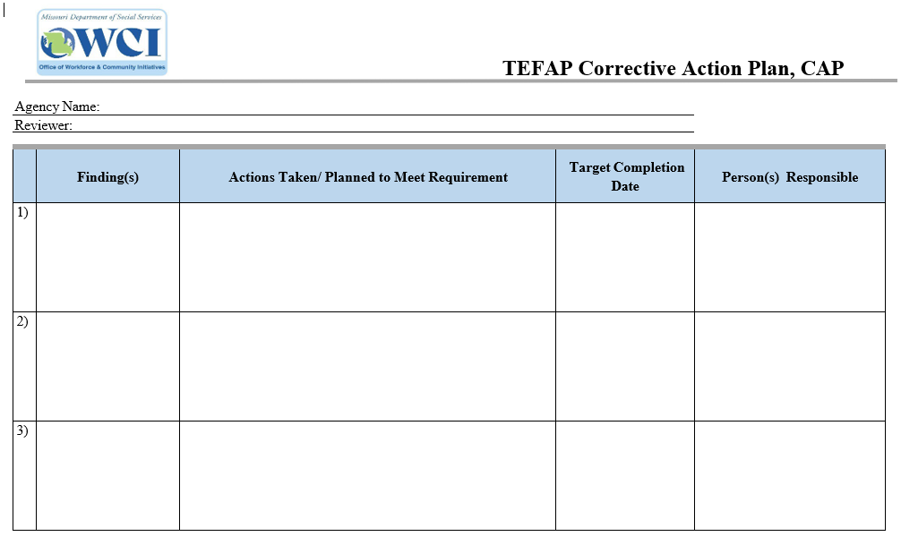
Corrective Action Plan Process
CAP Guidlines
  Must be submitted within 30 day
  Include Proof with Pictures or Documents
  Clearly indicate dates completed and Owner
  ARC will work with you closely and submit CAP on your behalf

Slide 120
Q&A

Slide 121


PROVIDED BY

Slide 122
Service Insights
with Jeremy & Deb

Slide 123
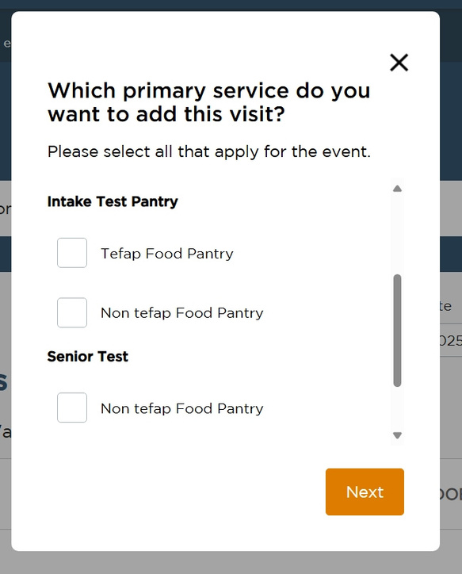
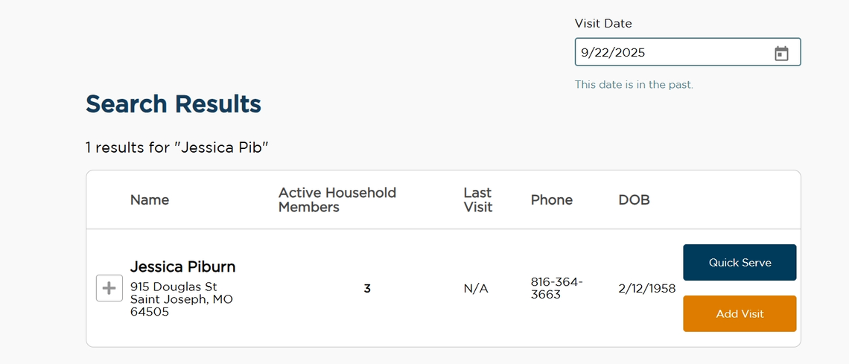
Service Insights Best Practices
Intake:
  Use Quick Serve for all non-TEFAP events when no updates are needed
  Be sure the service matches what the neighbor recieves, use the correct intake form
  Try to get all the neighbors information into the system for reports and easier searching

Slide 124
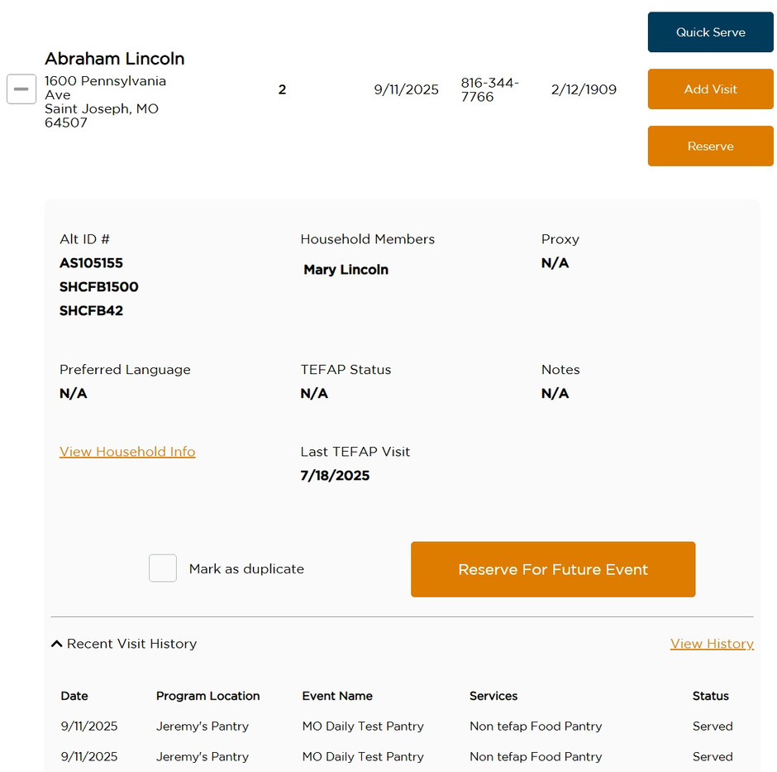
Service Insights Best Practices
  Always check the neighbor’s history and zip or county before distributing TEFAP
  If it isn’t captured in Service Insights, we must have a paper TEFAP report

Slide 125
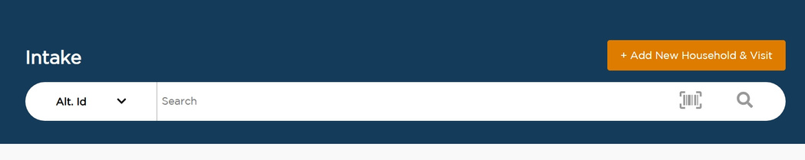
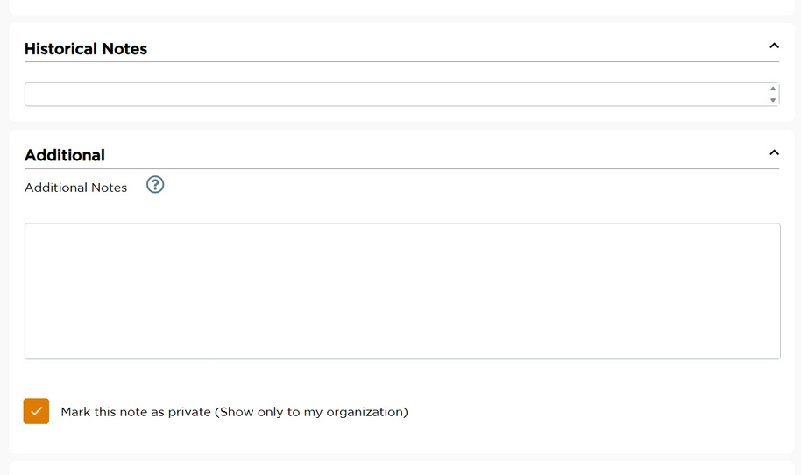
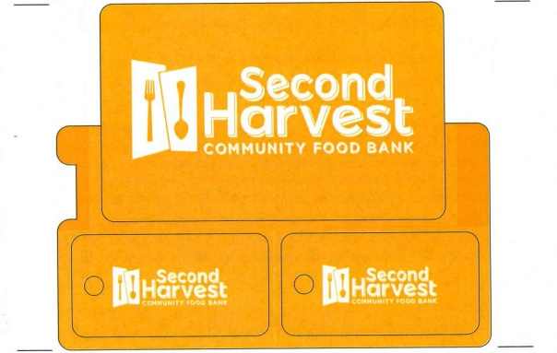
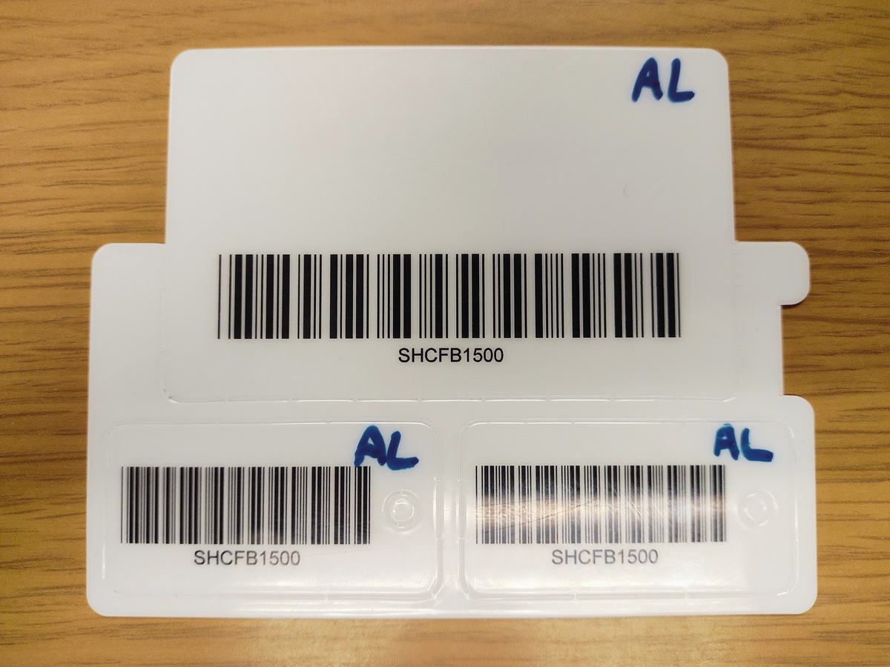
Service Insights Best Practices
  Use the keycard scan feature
  Use the notes section for private notes and network wide notes

Slide 126
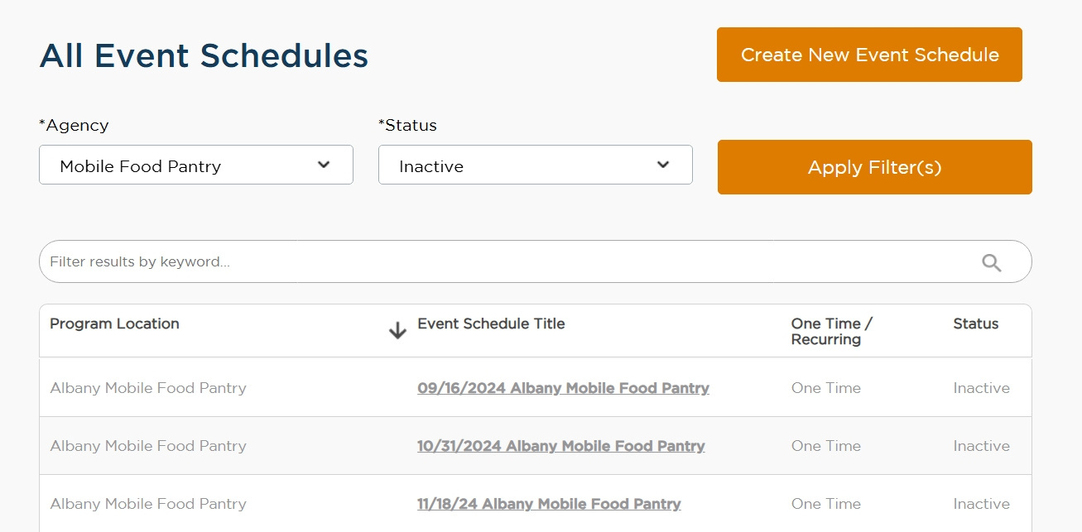
Service Insights Best Practices
Events:
  Add dates to the title of one-time events
  Change past events to Inactive
  Check for Holidays around reoccuring events

Slide 127
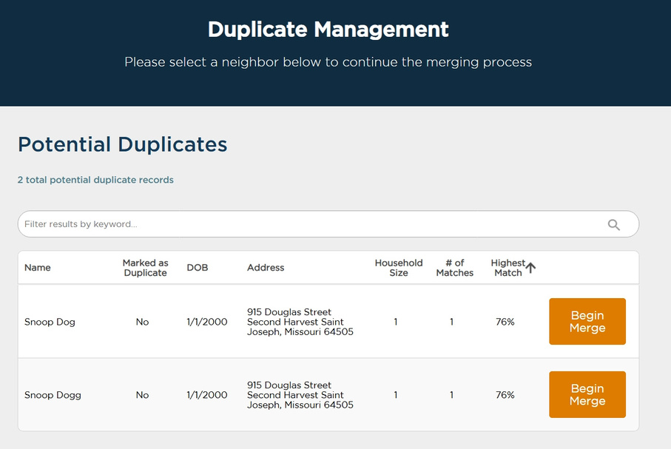
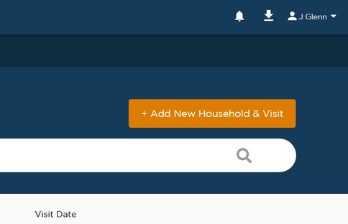
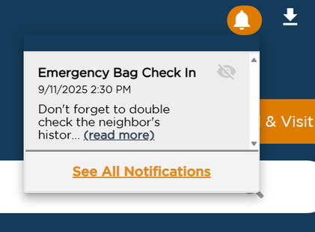
Service Insights Best Practices
Administrative:
  Look for notifications by clicking the bell on the home screen
  Remember...whatever you put in Service Insights....stays in Service Insights!
  Check for duplicates monthly using Duplicate Management

Slide 128
Service Insights Best Practices
  Always reach out for help if you need it.
Jeremy Glenn
Programs Manager
915 Douglas
St. Joseph, MO 64505
Phone: 816.364.FOOD, Ext 221

Slide 129
QUESTIONS?

Slide 130
THANK YOU FOR SERVING YOUR NEIGHBORS IN NEED!

